Slide 1
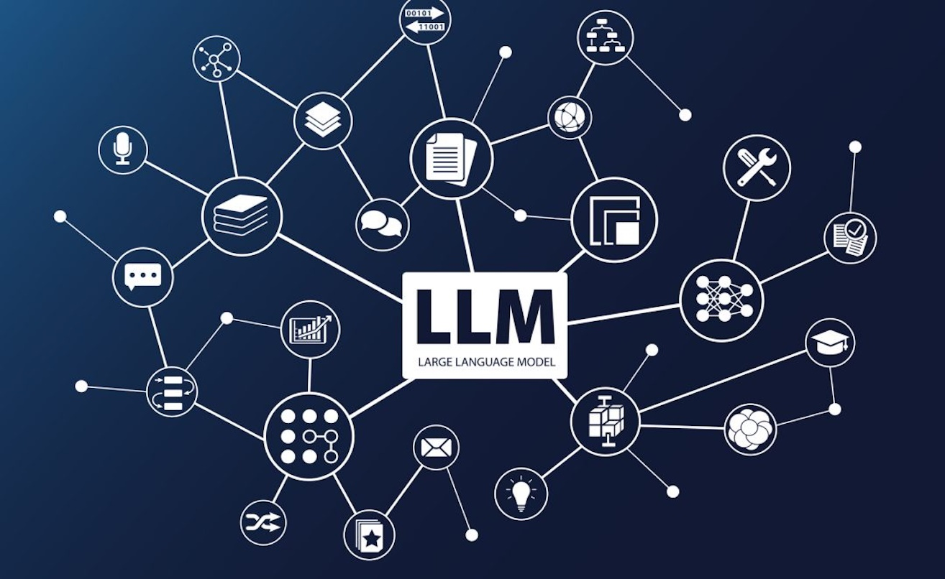
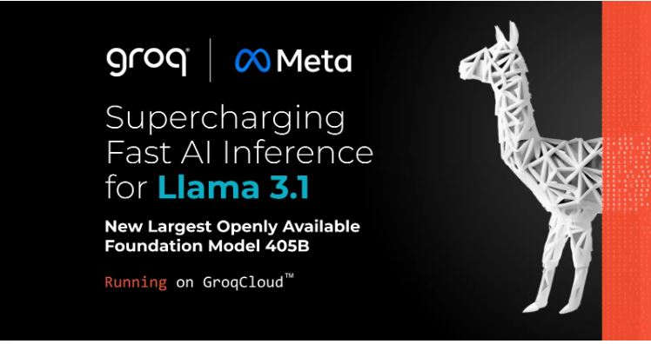

Building A News Research Tool-LLM Model
Project 9-Building A News Research Tool
Name-Debasis Panda
Group-VI

Slide 2
News Research Tool – Flow
Environment Set up
Lang Chain Configuration
Building Streamlit Interface
Enhancing the Tool
Testing and Validation
Findings and Conclusion

Slide 3
Overview
Problem: Equity research requires manual analysis of vast amounts of data, making it time-consuming.
Solution: Develop an AI-powered tool to automate news summarization and analysis.
Benefits: Increased efficiency, improved accuracy, enhanced decision-making.
Introduction
This project focuses on building a streamlined, LLM-powered news research tool using:
- LangChain for LLM orchestration
- Groq for high-speed model inference
- Streamlit for an interactive web UI
It enables users to extract and analyze news data effectively.

Slide 4
Environment Set up
VSCode : Used as the development platform.
Python (v3.10+)
Libraries: langchain, streamlit, newsapi, yfinance, etc., for news retrieval, summarization, and financial data.
API Keys: Obtained from Groq and configured for News API and other services.
Lang Chain Configuration
Import LLM_chain: From langchain_config, likely containing LLM and prompt setup.
News API: Used to fetch top headlines based on user queries.
fetch_latest_news function: Retrieves news and handles errors using try-except.
summarize_news function: Uses llm_chain to summarize the news articles.

Slide 5
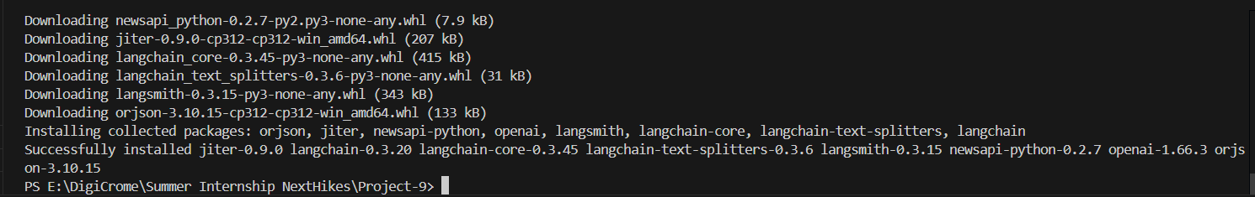
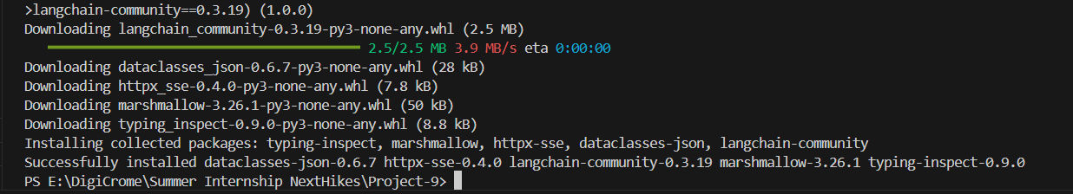
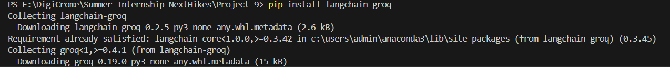
VSCODE- Environment Set UP
pip install langchain openai streamlit newsapi-python
pip install langchain-community==0.3.19
pip install langchain-groq

Slide 6
Building Streamlit Interface
Title and Input: Displays title and a text input for user queries.
Get News Button: Triggers news retrieval and summarization.
Output Display: Presents summarized news using st.write.
Session State: Stores latest news and timestamp for efficient updates.
Auto Refresh : After every 300secs the interface gets refreshed to get updated news
Enhancing the Tool
Sentiment Analysis: (Potential) To understand the tone of news articles.
Financial Data: (Potential) Integration with yfinance for stock data. Similarly importing various other open source library for more specific news like lifetime, geopandas
Data Visualization: (Potential) Graphs and charts for insights.
Customization: (Potential) User settings for query refinement like filtering by date, key word etc

Slide 7
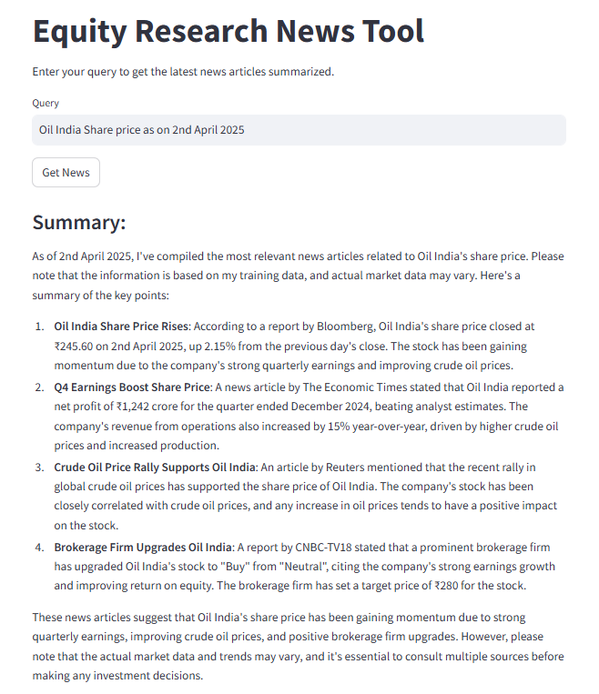
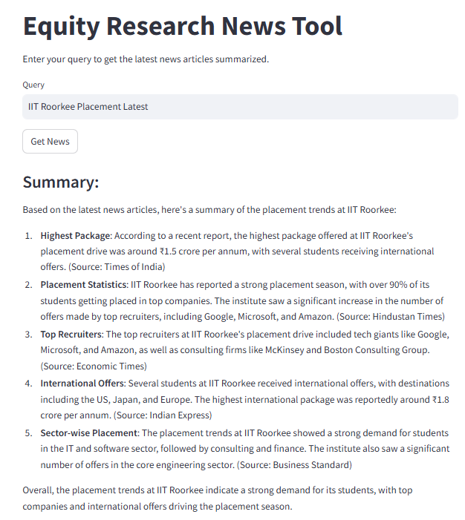
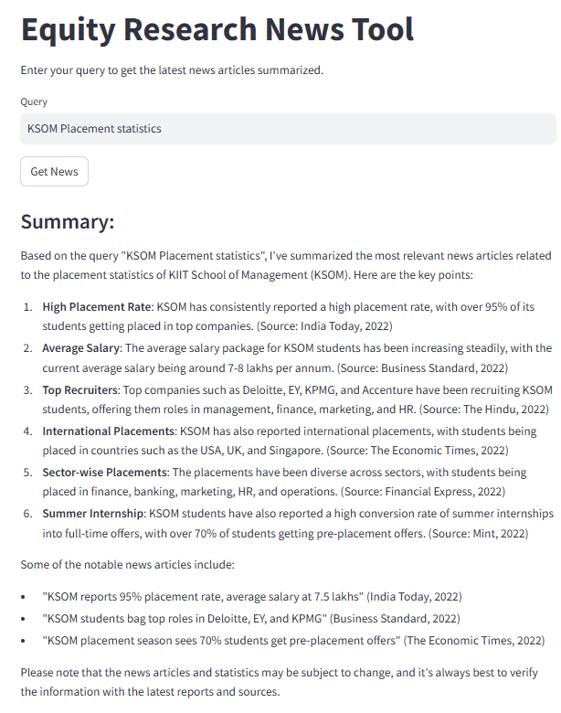
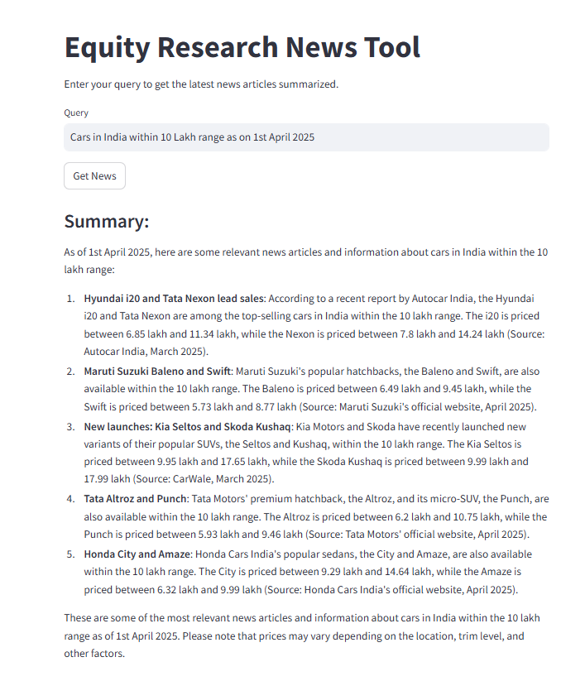
News API Response-Streamlit
Fig-1
Fig-2
Fig-3
Interpretation:
Streamlit able to fetch the real time stock price based on date –Fig-1
Fig -2,3 For institutions placement it was able to accumulate relevant information
Auto sector price specific query it was able to fetch –Fig-4
Fig-4
Notes:
exthikes | Internship Project Training | C-280424-TH2PM-B6
# Import Libraries from dotenv import load_dotenv import os from newsapi import NewsApiClient from langchain_groq import ChatGroq from langchain_core.prompts import PromptTemplate # Load environment variables from .env file load_dotenv() # Retrieve API keys newsapi_key = os.getenv("NEWSAPI_KEY") groq_api_key = os.getenv("GROQ_API_KEY") # Initialize NewsAPI newsapi = NewsApiClient(api_key=newsapi_key) # Initialize Chat Groq LLM groq_llm = ChatGroq( temperature=0, model = 'model_name', groq_api_key = groq_api_key ) # Define the prompt template template = """ You are an AI assistant helping an equity research analyst. Given the following query and the provided news article summaries, provide an overall summary. Query: {query} Summaries: {summaries} """ # Create the prompt prompt = PromptTemplate.from_template(template) # Combine prompt and LLM into a pipeline pipeline = prompt | groq_llm # Function to fetch news articles using NewsAPI def get_news_articles(query): articles = newsapi.get_everything(q=query, language="en", sort_by="relevancy") return articles["articles"] # Function to summarize news articles def summarize_articles(articles): summaries = [] for article in articles[:5]: # Limit to top 5 articles summaries.append(article["description"] or "No description available") return " ".join(summaries) # Function to generate the final summary using Groq LLM def get_summary(query): articles = get_news_articles(query) article_summaries = summarize_articles(articles) pipeline = prompt | groq_llm response = pipeline.invoke({"query": query, "summaries": article_summaries}) summary = response.content return summary # Now it returns only the clean summary # Test the enhanced setup if __name__ == "__main__": test_query = "Impact of inflation on stock markets" try: summary = get_summary(test_query) print("Generated Enhanced Summary:") print(summary) except Exception as e: print(f"Error: {e}")
04:55 AM

Slide 8
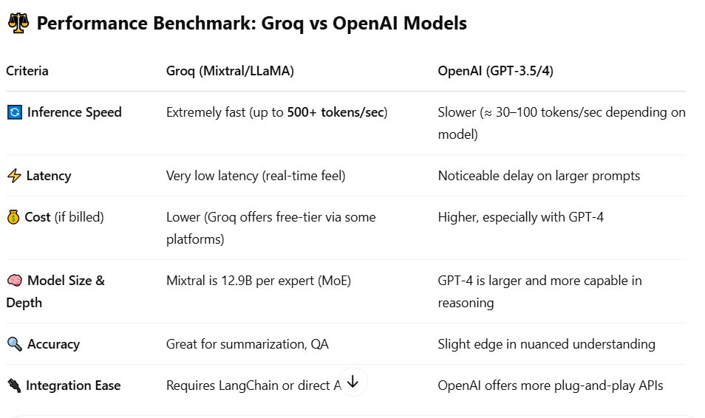
Testing and Validation
- Unit testing for key components
- Manual validation of news summaries
- Performance benchmark on Groq vs OpenAI models
Interpretation
Groq excels in speed and real-time response.
OpenAI models are stronger in reasoning-heavy or complex language tasks.

Slide 9
Conclusion
- LLMs are effective for summarizing real-time news
- Groq-enabled models offer faster inference speeds
- Streamlit is a user-friendly choice for rapid prototyping
- Future scope: sentiment analysis, email alerts, filtering, trend clustering
THANK YOU

